Slide 1
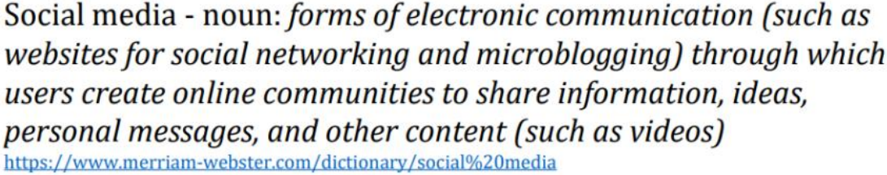
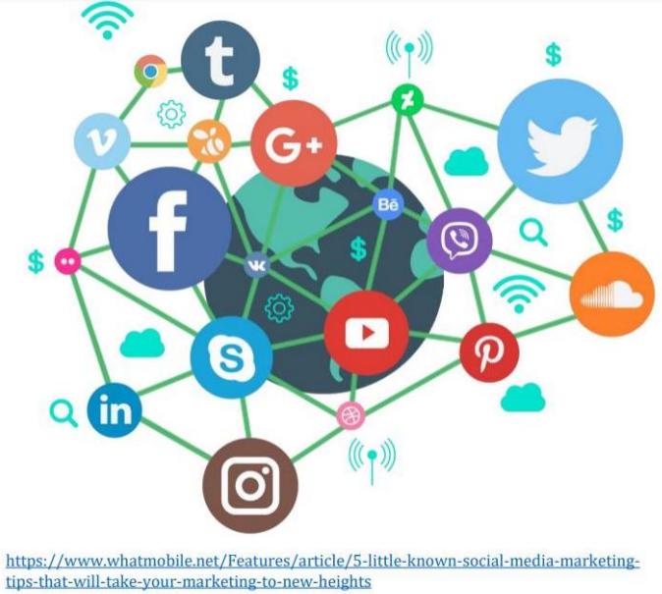
Topic
The Impacts of Social Media on Society
Due to the exponential growth of Social Media platforms, more of humanity is influenced by the decisions of these platforms than ever before.
Because of this, a large portion of earths inhabitants are stakeholders in these platforms, who are influenced and effected by their actions.
It is important, now more than ever, to analyze their impact on our society.
https://ourworldindata.org/exports/users-by-social-media-platform-21198d8bd2c0cdb46ee348b18501fb83_v11_850x600.svg
Opportunities
1. In business, the enterprise can target and appeal to consumers easily through effective and efficient marketing.
2. For individuals, they have more job opportunities through social media and job seekers can be easy to find a job through websites such as a LinkedIn.
3. In education, schools can prevent being unable to teach students by providing access to lectures and classes online.
Made by: Charlie Renton-Deans & Seongrok Shin

Slide 2
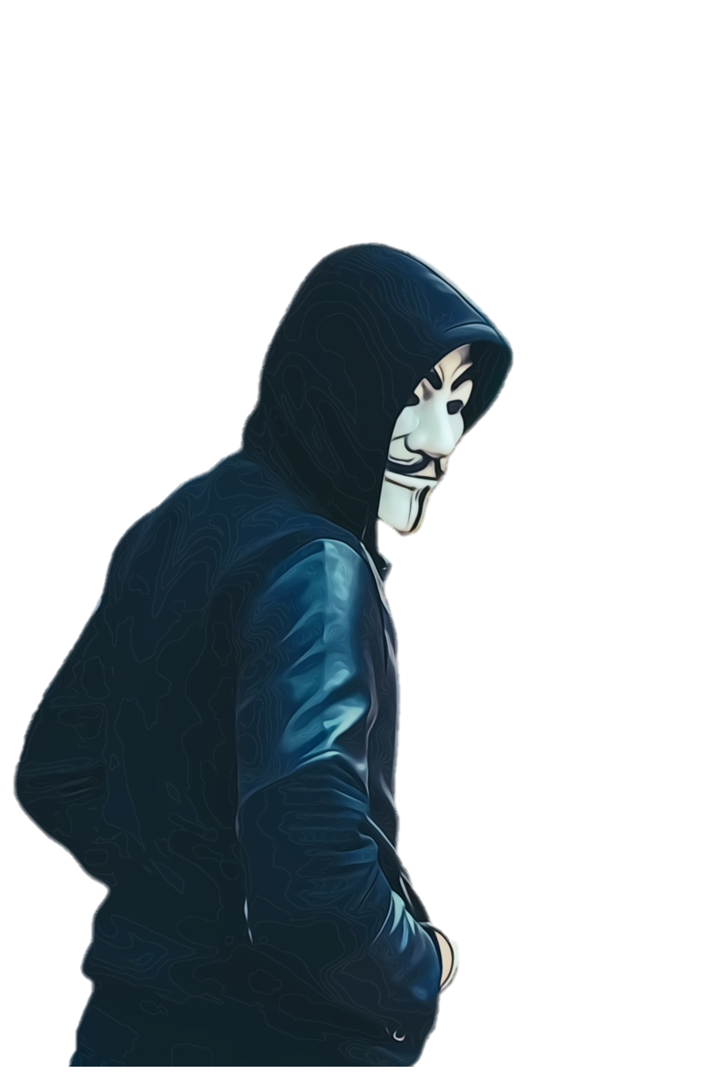

Risks
The Impacts of Social Media on Society
Most social media apps track your phone, such as what you search and look at and give relative adds
Choices
Privacy
Some companies have been losing money due to workers productivity loss from using social media apps
Choosing which information to collect. Presenting personal data to customers. (Photos)
Data
Productivity Loss
Deciding which activity to track. Used to provide ads that are personalized.
Social media platform users taking matters into their own hands to be judge, jury, and executioner
Targeted Advertising
Vigilantism
Free choice of consumers to decide which media platform to communicate with (e.g. Messenger)
Free Communication
Made by: Charlie Renton-Deans & Jason Rau

Slide 3
The Impacts of Social Media on Society
Team Roles
Jason | Seongrok | Charlie
Website development, referencing management, and research | Website development and lead researcher | Website CSS, GitHub Management, and Assignment Requirement Manager
Sources
(Social Media Size Data)https://ourworldindata.org/exports/users-by-social-media-platform-21198d8bd2c0cdb46ee348b18501fb83_v11_850x600.svg
(W3 Schools – CSS Verical Nav Bar)https://www.w3schools.com/css/css_navbar_vertical.asp
(W3 Docs – How to Embed PDF in HTML)https://www.w3docs.com/snippets/html/how-to-embed-pdf-in-html.html
(W3 Schools – CSS Table Style)https://www.w3schools.com/css/css_table_style.asp
(Holding Cards)https://www.frontlinegaming.org/wp-content/uploads/2019/11/hand-of-cards-768x576.jpg
(Collage of “Social Media Posts”)https://miro.medium.com/max/1075/1*2A-w-KONim5R459GyY_E8Q.png
(Various Social Media Logos)https://static.vecteezy.com/system/resources/previews/000/095/039/original/free-social-media-icons-vector.png
(Forbes – Kalev Leetaru (2019))https://www.forbes.com/sites/kalevleetaru/2018/10/25/social-media-companies-collect-so-much-data-even-they-cant-remember-all-the-ways-they-surveil-us/?sh=40809d0b7d0b
(Top Gear – BBC)https://i.imgur.com/yJyQweT.png
(Person in Hoodie)https://www.cleanpng.com/png-hoodie-beanie-balaclava-cobalt-blue-7252213/
(Data Privacy Image)https://www.aggateway.org/portals/1010/WebSite/Newsroom/Newsletter/2020/JULY/Data%20privacy.jpg?ver=2020-07-23-111924-337
(Definition of Social media)https://www.investopedia.com/terms/s/social-media.asp
(TOP7 Social Media Apps)https://www.adobe.com/express/learn/blog/top-social-media-sites
Made by: Charlie Renton-Deans & Jason Rau

